Slide 1
MALIGNANT COMMENTS CLASSIFICATION
Made by: Rahul Adhwaria

Slide 2
Steps and assumptions
The proliferation of social media enables people to express their opinions widely online. However, at the same time, this has resulted in the emergence of conflict and hate, making online environments uninviting for users. Although researchers have found that hate is a problem across multiple platforms, there is a lack of models for online hate detection.
Online hate, described as abusive language, aggression, cyberbullying, hatefulness and many others has been identified as a major threat on online social media platforms. Social media platforms are the most prominent grounds for such toxic behaviour.
There has been a remarkable increase in the cases of cyberbullying and trolls on various social media platforms. Many celebrities and influences are facing backlashes from people and have to come across hateful and offensive comments. This can take a toll on anyone and affect them mentally leading to depression, mental illness, self-hatred and suicidal thoughts.

Slide 3
Internet comments are bastions of hatred and vitriol. While online anonymity has provided a new outlet for aggression and hate speech, machine learning can be used to fight it. The problem we sought to solve was the tagging of internet comments that are aggressive towards other users. This means that insults to third parties such as celebrities will be tagged as unoffensive, but “u are an idiot” is clearly offensive.
Our goal is to build a prototype of online hate and abuse comment classifier which can used to classify hate and offensive comments so that it can be controlled and restricted from spreading hatred and cyberbullying.

Slide 4
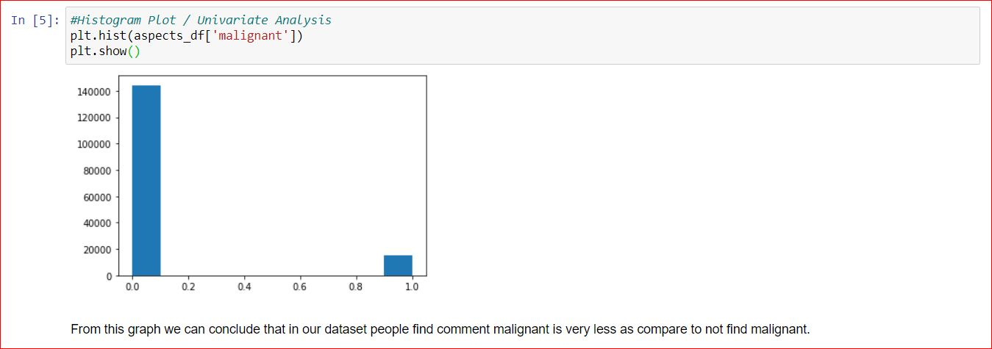
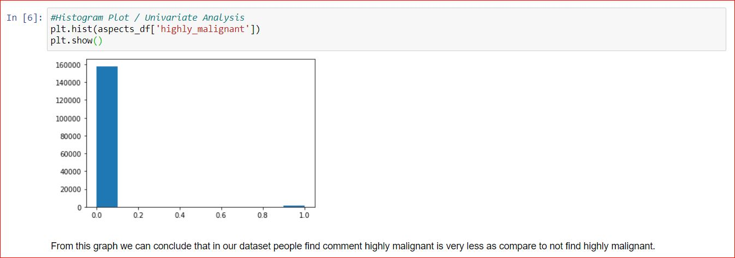
EDA steps and Visualizations
From this graph we can conclude that in our dataset people find comment malignant is very less as compare to not find malignant.
From this graph we can conclude that in our dataset people find comment highly malignant is very less as compare to not find highly malignant.

Slide 5
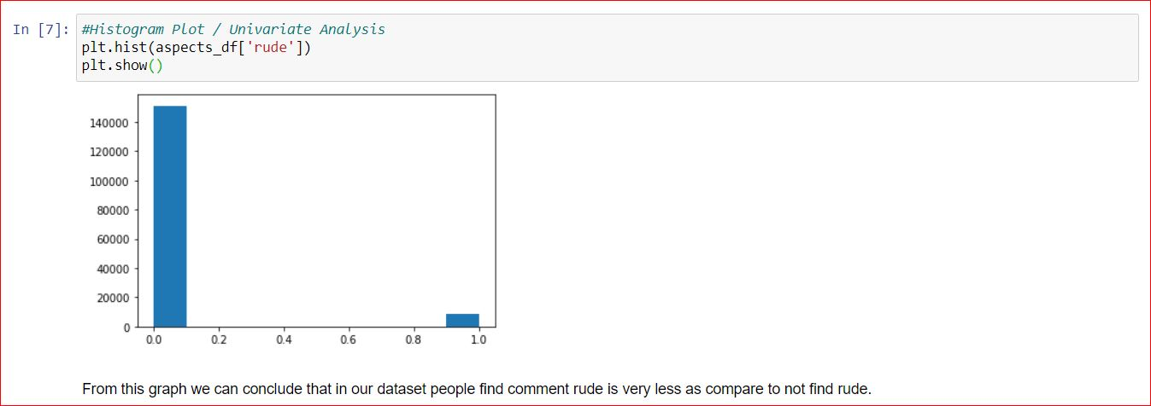
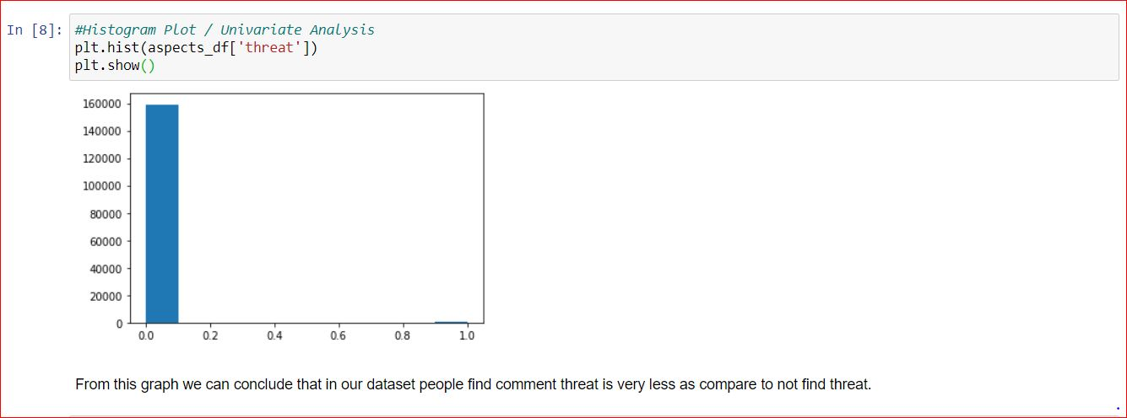
From this graph we can conclude that in our dataset people find comment rude is very less as compare to not find rude.
From this graph we can conclude that in our dataset people find comment threat is very less as compare to not find threat.

Slide 6
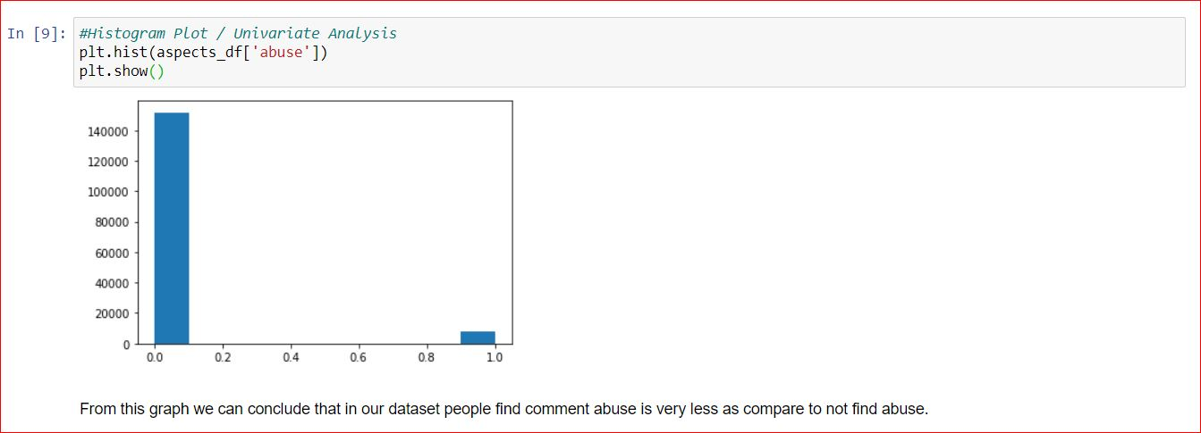
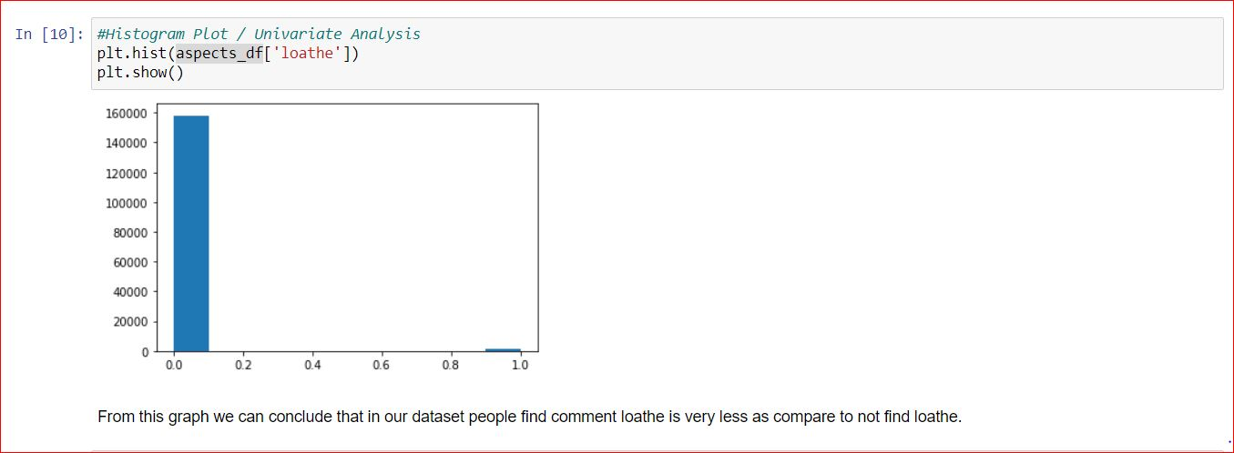
From this graph we can conclude that in our dataset people find comment abuse is very less as compare to not find abuse.
From this graph we can conclude that in our dataset people find comment loathe is very less as compare to not find loathe.

Slide 7
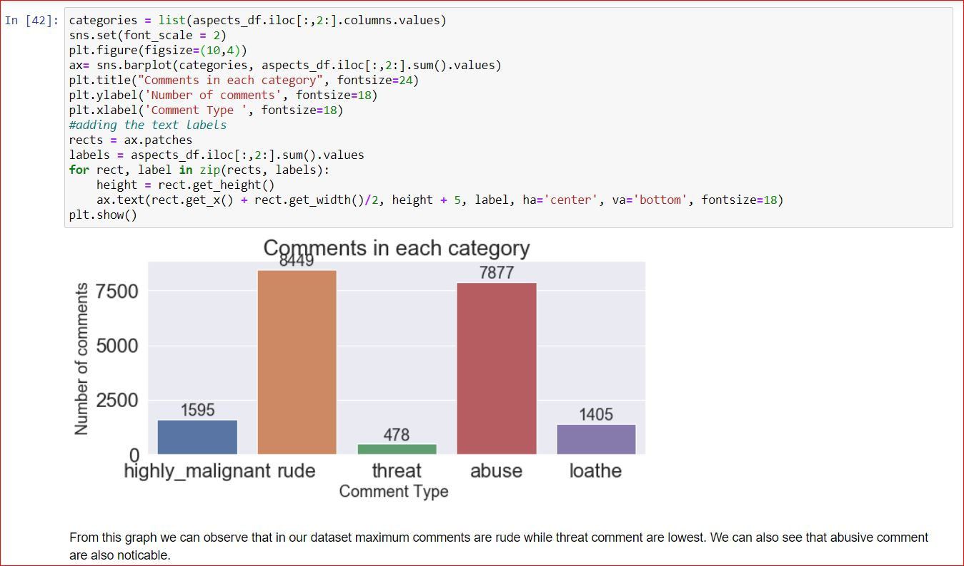
From this graph we can observe that in our dataset maximum comments are rude while threat comment are lowest. We can also see that abusive comment are also noticable.

Slide 8
Steps and assumptions
In the starting we load our train dataset. After that we did data cleaning, firstly we understand the feature of dataset, then we plot some required graph which is shown below and make all letter in lower case etc. Then we import NLP library, and we split sentence into word tokenization, then we remove stopwords and punctuations. Then we sent our data to tf-idf method to convert into numbers, so that we can build ML model which will use a best fit model in future, if I have comment text or reviews then I can predict comment text or reviews respectively. In our case we find Decision tree Classifier as the best model.
Then we load our test dataset and transform it by tf-idf method and predict the required data as per the train model building.

Slide 9
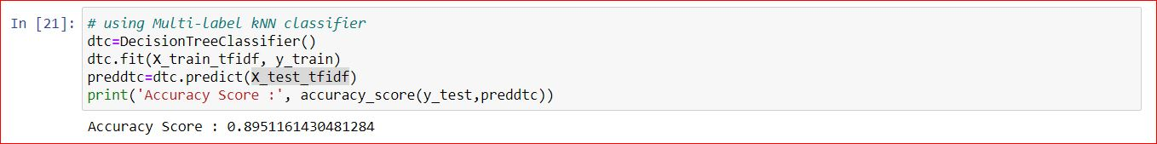
Model Dashboard
As in our target variable we have categorical values, and we know that this type of dataset falls under classification. So we use Decision Tree Classifier to predict the test data. In this algorithm we are getting accuracy of 89%.

Slide 10
Problem Statement and Understanding
In univariate analysis we count the presence of 1 and 0 in ‘Malignant’, ‘Highly malignant’, ‘Rude’, ‘Threat’, ‘Abuse’ and ‘Loathe’.
In bivariate analysis we find the relation between ‘Malignant’, ‘Highly malignant’, ‘Rude’, ‘Threat’, ‘Abuse’ and ‘Loathe’.
In model building we find Decision Tree Classifier is the best algorithm. We find the accuracy score of 89% in this algorithm.

Slide 11


